Slide 1



Green Energy Nayland
Public meeting – February 17th 2011

Slide 2
Agenda
Why are we doing this?
What is Green Energy Nayland?
The opportunity for investors
Questions
Notes:
2

Slide 3
Fossil fuel dependency
Nayland mirrors the pattern seen in most rich countries
  High energy consumption
  Economy linked to growing consumption
  High dependency on fossil fuels

Slide 4
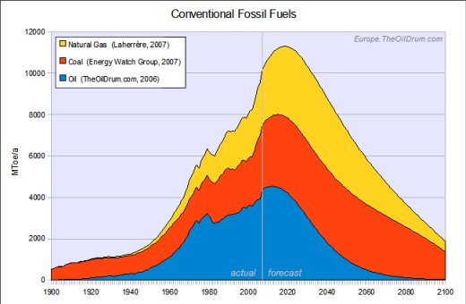
Seem to be hitting limits

Slide 5
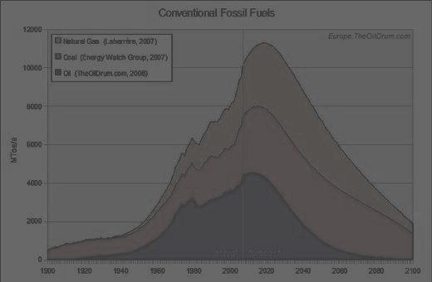
Seem to be hitting limits
Limited supply raises the price
  eg. price spike in oil this winter
  long term prediction of higher prices for all energy
Limited capacity of atmosphere to absorb CO₂
Limits to domestic production
  energy security risk through reliance on overseas supply

Slide 6
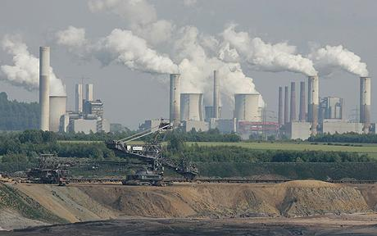
Most electricity still comes from fossil fuels
74%
Only 5% from renewable sources

Slide 7
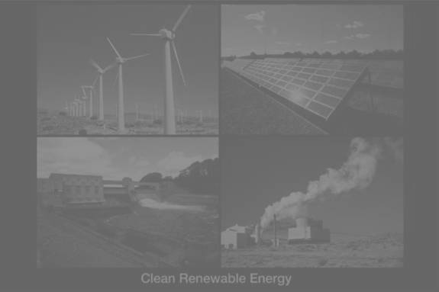
Policy response
15% of all energy to come from renewable sources by 2020
Financial incentives put in place
    Feed in Tariff
    Renewable Heat Incentive
    Insulation funding
    VAT reduction for renewable energy systems

Slide 8
Why a community scale project is important
Community schemes are a key part of the Government’s strategy to achieve its targets for energy production
Increased efficiency of local model of energy production:
  many small generators close to demand are better than 1 central one
  no transmission losses/costs
  no new pylons
Direct benefits to the LOCAL community

Slide 9
How will GEN work?

Slide 10
How will GEN work?
Industrial & Provident Society
For “community benefit”
Owned by members
One member one vote
Rules approved by FSA
Assets can’t be sold

Slide 11
Different to a Ltd company
Shares cannot be sold
  But may be able to be withdrawn
Pays interest gross
Needs to show a community benefit
Cannot freely dispose of its assets

Slide 12
The project
10kWp array on school roof
  Roof faces south
  Perfectly pitched slope
GEN will pay for and own the panels
GEN will collect the revenue for 25 years
  Revenue will come from the legally controlled Feed In Tariff
School will insure against physical risks
School gets discount electricity

Slide 13
The investment opportunity
Project forecast to cost £32,000
We need to raise this from members
Minimum investment £250
Maximum £20,000
Share offer open from now until March 4th
Aim to offer an attractive financial return to members

Slide 14
Attractive financial return
1st year surplus est. £2700
  Before provision for withdrawals
Feed in Tariff rises with RPI for 25 years
Annual surplus will be used to pay interest
Initial interest rate approx 4%
  Not guaranteed
Lifetime return approx 8% pa
Aim to qualify for EIS relief
  20% cash back from HMRC

Slide 15
Withdrawals
No transfers of shares
Withdrawals after 3 years
Directors will retain enough of the surplus to fund withdrawals
Withdrawals increase the interest for remaining shareholders
Income will rise over time with RPI
Longer term shareholders will get a better return

Slide 16
Sharing the benefits
Investors
  Lower return than a commercial funder would seek
  But better than in a bank/building society
  Emotional content to the investment
School
  Cheap electricity
  Educational resource
  Free system after 25 years
Community
  Energy security
  Environment

Slide 17
Further projects
School project could double in size
  If this offer is oversusbscribed
Other public buildings
  Village hall, fire station etc
Commitment to consult members before investing

Slide 18
Actions
Download prospectus at…..
  www.greenenergynayland.org.uk
Send off application and cheque
Application closure is 4th March, 2011
Install system on school before the long sunny summer of 2011

Slide 19
Questions?

